Slide 1
Information Retrieval from Microblogs during Disasters (IRMiDis)
By:
Hemant Gaur

Slide 2
Explanation of the Task-1
In case of calamities and disasters, various people have different instances towards the policies of government.
So to know the general stand of people a sentiment classifier is required
Building an effective classifier to predict the user stance (towards vaccines) from social media posts (e.g., microblogs) becomes a crucial first step in any kind of analysis towards vaccine stance.
We made a classifier that classifies peoples in three categories based on their views.
Classifier separates in three classes namely Pro-Vax, Anti-vax, neutral.

Slide 3
Task 2: Detection of COVID-19 symptom-reporting in tweets
Identification of disease like covid at early stage helps in taking precautionary steps early.
For this we need to make a model that explore if tweets that report about someone experiencing COVID-19 symptoms (e.g., ‘fever’, ‘cough’) .
simply identifying tweets that contain mentions of COVID-19 symptoms is not helpful, since these tweets can contain lots of irrelevant information
Hence a classifier is made that to understand which tweets actually inform about someone experiencing COVID-19 symptoms
A classifier with 4 class classification is made that segregates into primary reporting, secondary reporting , third-party reporting and non- reporting.

Slide 4
Explaining the dataset(Task-1 & Tast-2)
around 4,390 tweets as training data from two sources is used
Around 1600 labeled data for training
Around 500 for test
For task 2, crawled English tweets from February 2020- June 2021 using keywords related to COVID-19 symptoms
2000 total tweets are selected randomly and 80%-20% division of train and test is performed.

Slide 5
Libraries used in making models
nltk
Tensorflow
Sklearn
Transformers
BERT
. tnnnn

Slide 6
Explaining the Tast-1 code

Slide 7
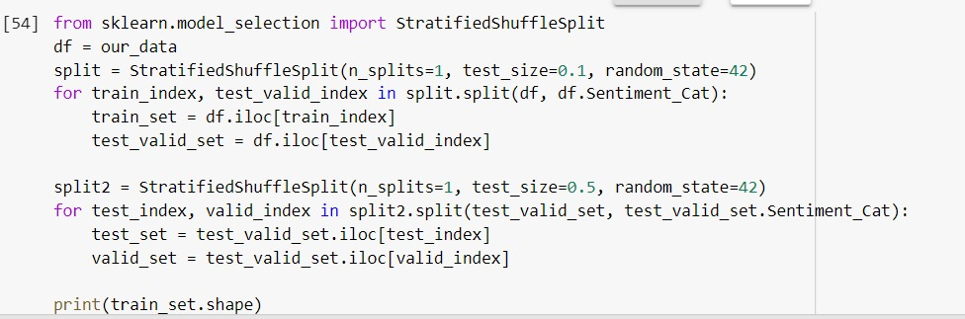
Data split
In this code, the data is spli into train and test with various parameters like test_size, random _state etc.
For splitting , stratified shuffle split

Slide 8
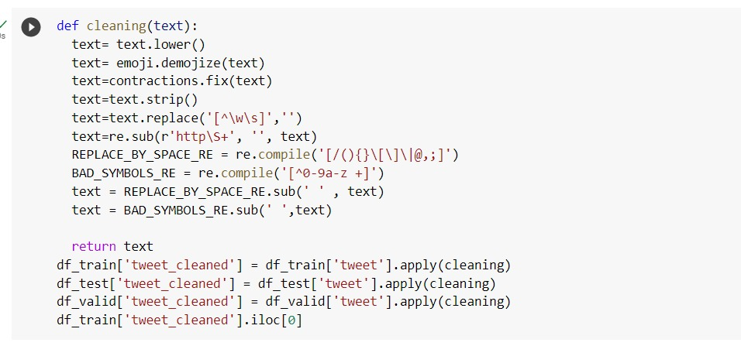
Data cleaning
To remove various unnecessary tokens like emojis, links, special character, a function named cleaning is used
This cleans the data and make it appropriate for next step

Slide 9
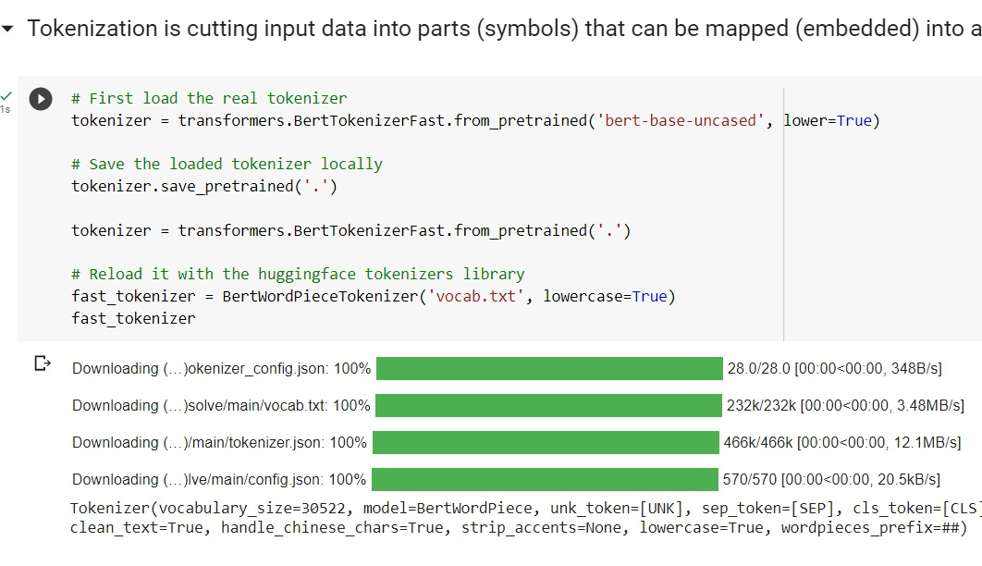
function for transforming and encoding into vector space

Slide 10
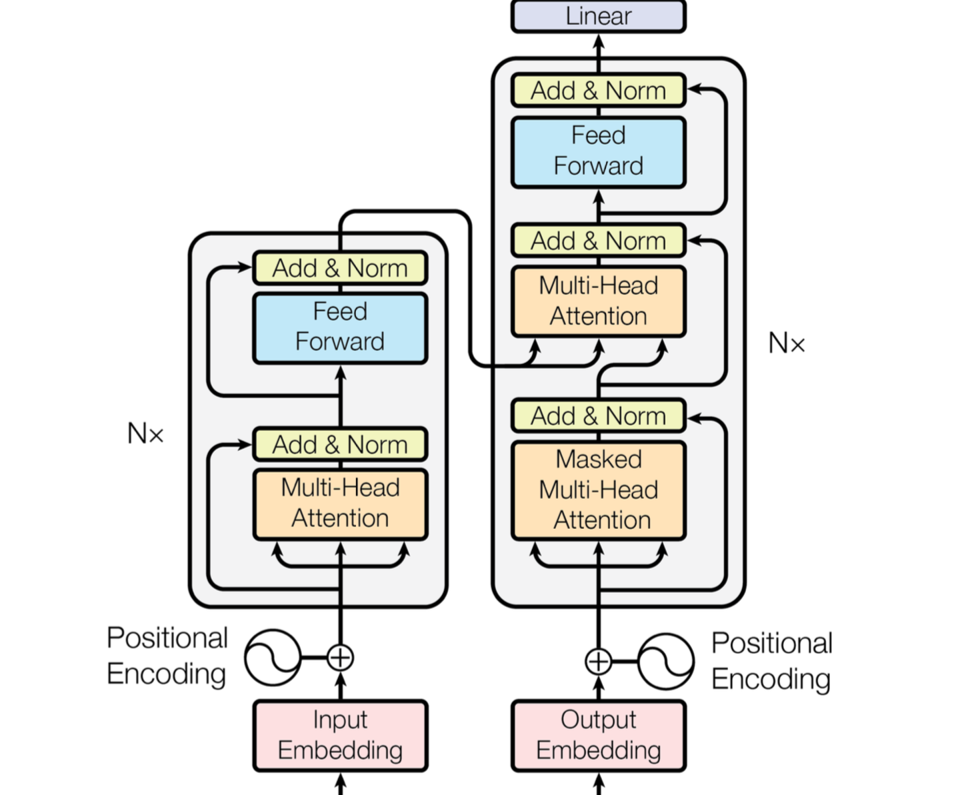
Use of Language model BERT
BERT generates word embeddings that take into account the context in which the word appears. This means that the same word can have different embeddings depending on its context
BERT is a bidirectional, which means that it can take into account the entire context of a sentence. This can lead to more accurate predictions

Slide 11
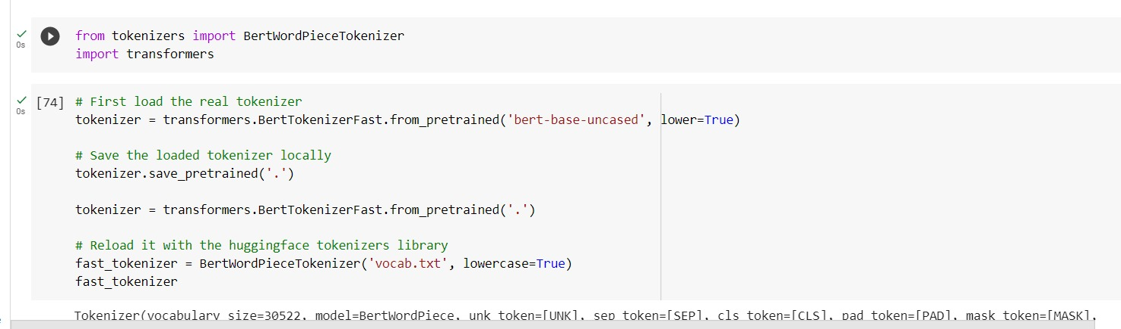
Use of transformers
Transformers are used primarily because adopts the mechanism of self-attention, differentially weighting the significance of each part of the input (which includes the recursive output) data.

Slide 12
Results output example

Slide 13
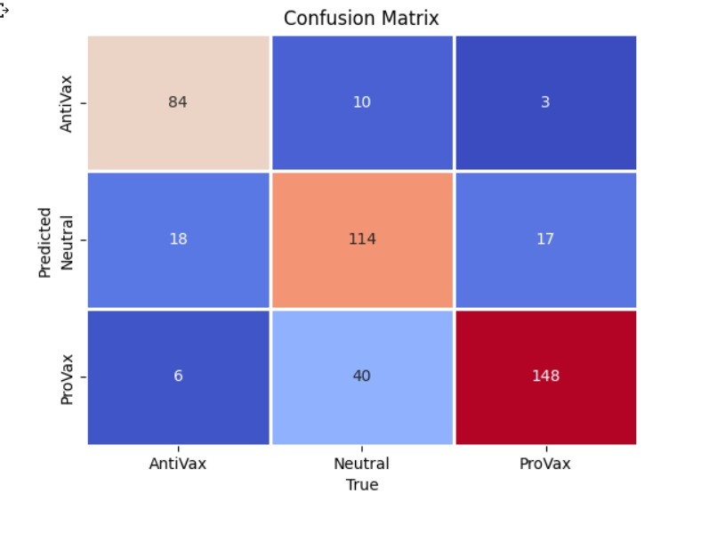
Confusion Matrix

Slide 14
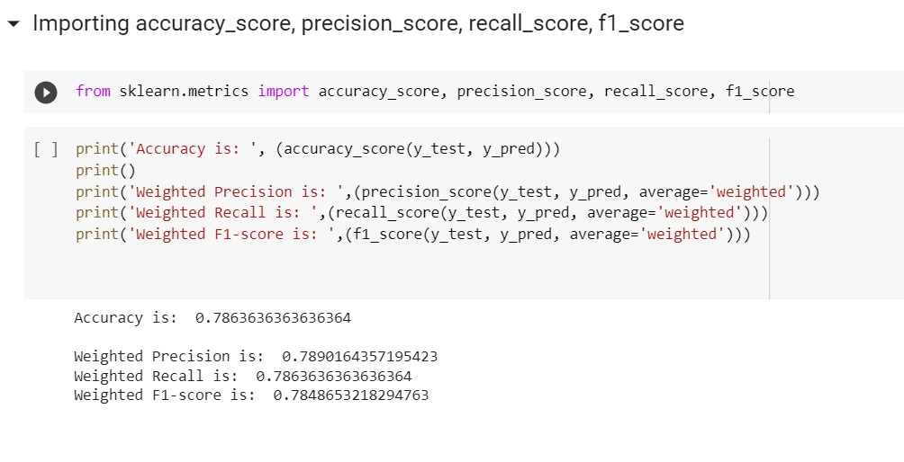
Precision Recall And Accuracy

Slide 15
Output of Task-2

Slide 16
Thank You

